Slide 1

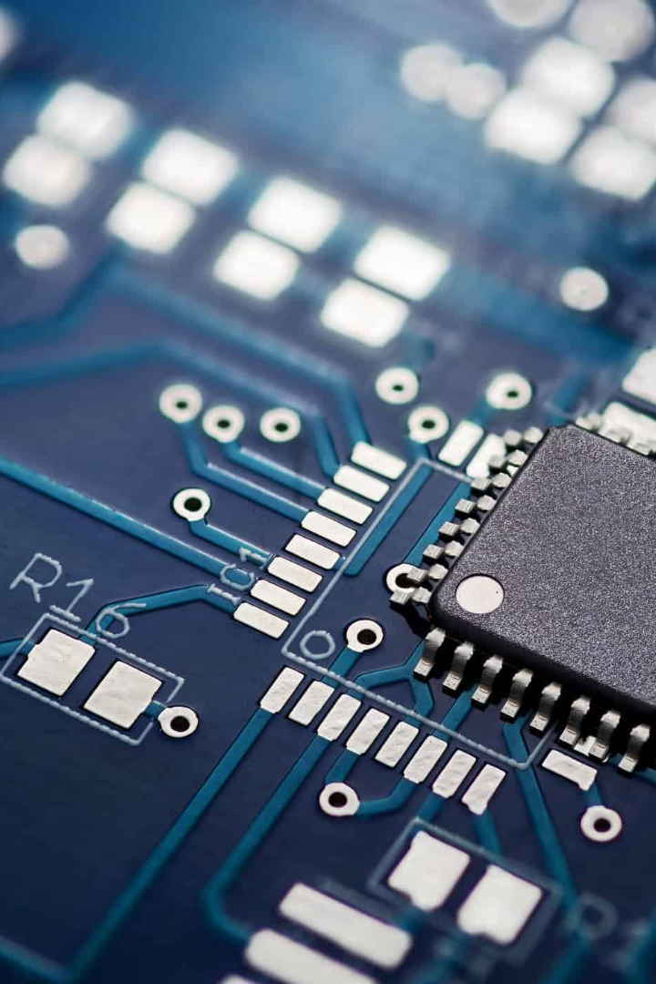
Advances in Semiconductor Technology
From Gallium Arsenide (GaAs) and SOI to Carbon Nanotube (CNT) based devices, this presentation explores the latest breakthroughs in the field of semiconductor technology.
By Deepak Kumar (2023PEV3227)
Mukul Kumar (2023PEV3227)

Slide 2



systems
GaAs
1
What is GaAs?
Gallium arsenide is a semiconductor material used in electronic devices. It offers high electron mobility and is commonly used in high-frequency applications.
High-Speed Transistors
Discover GaAs devices that enable high-speed signal processing and communication systems.
2
Applications
Efficient LEDs
GaAs is used in a wide range of products such as solar cells, LEDs, and microwave radio-frequency amplifiers.
Witness the brilliance of GaAs in producing efficient and powerful light-emitting diodes (LEDs).
3
Advantages
Compared to silicon, GaAs devices offer higher performance, faster switch speeds, and lower noise levels.

Slide 3

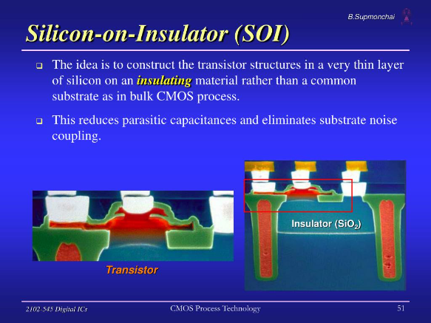
Advantages
SOI devices have lower power consumption, higher speed, and improved radiation hardness compared to other types of semiconductors.
What is SOI?
Silicon-on-insulator is a semiconductor manufacturing technology that involves layering a thin layer of silicon onto a substrate made of silicon dioxide.
Applications
SOI technology is used in microprocessors, memory devices, and RF components.

Slide 4
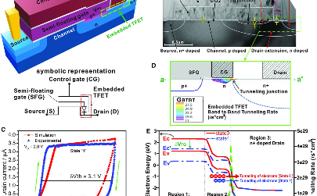
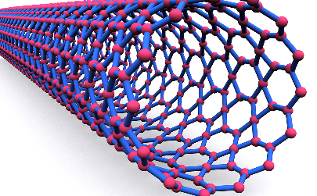
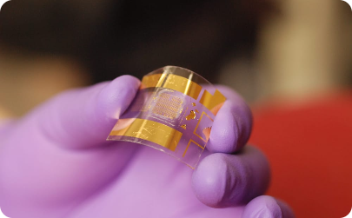
CNT-based Devices
Applications
Advantages
What are CNTs?
CNTs have high electrical conductivity, thermal conductivity, and mechanical strength, making them ideal for electronic components such as ultra-fast transistors and interconnects.
Carbon nanotubes are cylindrical molecules composed of carbon atoms arranged in a unique pattern.
CNT-based devices have potential applications in flexible electronics, sensors, and energy harvesting.

Slide 5
ITRS
1
What is the ITRS?
The International Technology Roadmap for Semiconductors is a collaborative effort between industry leaders to identify technology requirements and potential roadblocks.
Goals
2
The ITRS aims to anticipate and solve technical challenges in the semiconductor industry, such as device scaling, power management, and reliability.
3
Collaboration
The success of the ITRS depends on international collaboration and sharing of best practices.

Slide 6
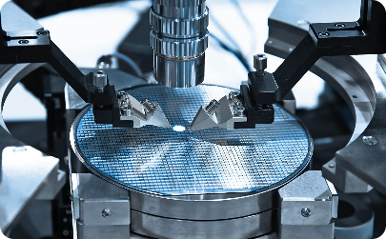

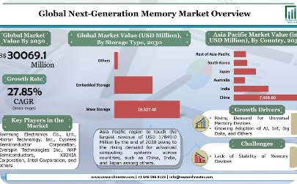
ITRS Roadmap Overview
Advanced Fabrication Techniques
Quantum Computing
Next-Generation Memory
Discover the ITRS roadmap's vision for harnessing the power of quantum computing in the semiconductor industry.
Delve into the roadmap's exploration of cutting-edge fabrication processes for future semiconductor manufacturing.
Learn about the development of innovative memory technologies to address the demands of data-intensive applications.

